Slide 1
PARAMETRIC SCREENING OF HYBRID POWERTRAIN ARCHITECTURES FOR HIGH-ENERGY LASER VEHICLES: APPLICATION TO FOXHOUND AND BOXER
Author: Rupert Tull de Salis¹, PE, MEng, MSc
Presenter: Wiktor Dotter, CEO powersize.tech

Slide 2
Contents
1. Motivation and Context
2. The Two Platforms: Foxhound and Boxer
3. HEL Classification: Classes A-E
4. Power and Mass Drivers (WPE, Thermal Management)
5. Engagement Cycle and Sustained Firing Fraction
6. HEL Electrical Demand and Mass by Class
7. Analysis Methodology: CEMP-H and powersize.tech
8. Parallel vs. Series Architectures
9. Results: Foxhound
10. Results: Boxer
11. Discussion: Synergies of Hybridization
12. Conclusions

Slide 3
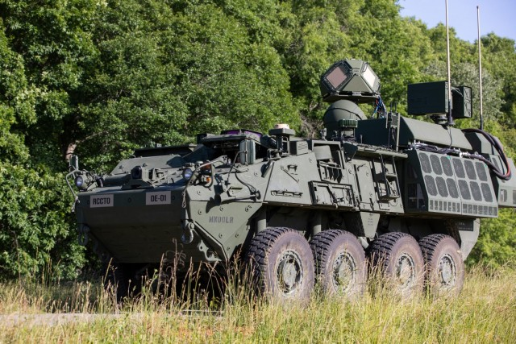
Motivation and Context
The threat:
Drone swarms dominate battlefield air threat;
HEL offers unlimited magazine, low cost per engagement, high sustained fire rate
Recent commitments:
US Army: 50 kW DE M-SHORAD on Stryker; 300 kW-class IFPC-HEL program.
UK MoD: ~£1 billion committed for DEW in 2025 Strategic Defence Review.
DragonFire ordered for Royal Navy.
The gap:
No published methodology for matching a HEL to a vehicle platform at concept stage, before weapon or vehicle parameters are frozen
This paper:
Introduces A-E HEL classification; estimates power and mass by class; screens hybrid powertrain architectures for Foxhound and Boxer using powersize.tech
Directed Energy Maneuver Short-Range Air Defense (DE M-SHORAD) 50 kW-class laser weapon system mounted on a Stryker A1 8×8 armored vehicle.
(U.S. Army photograph, public domain, DVIDS 9107830)

Slide 4
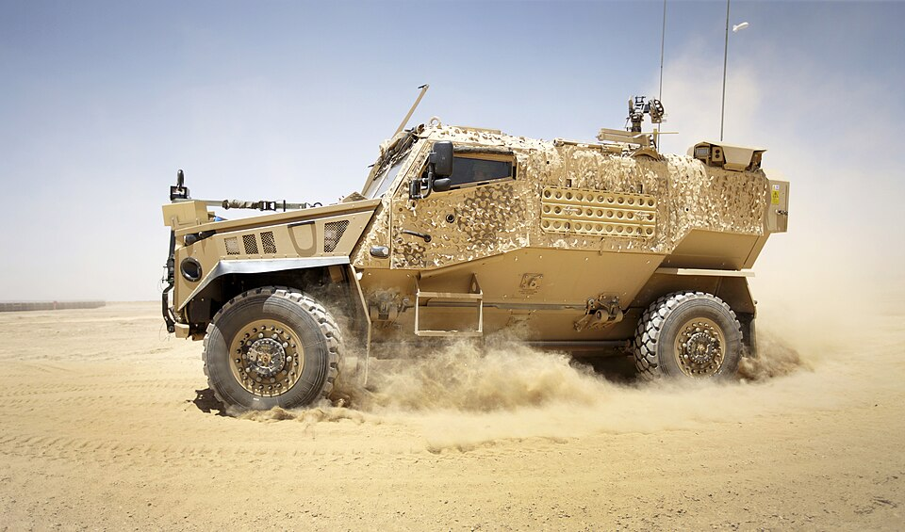
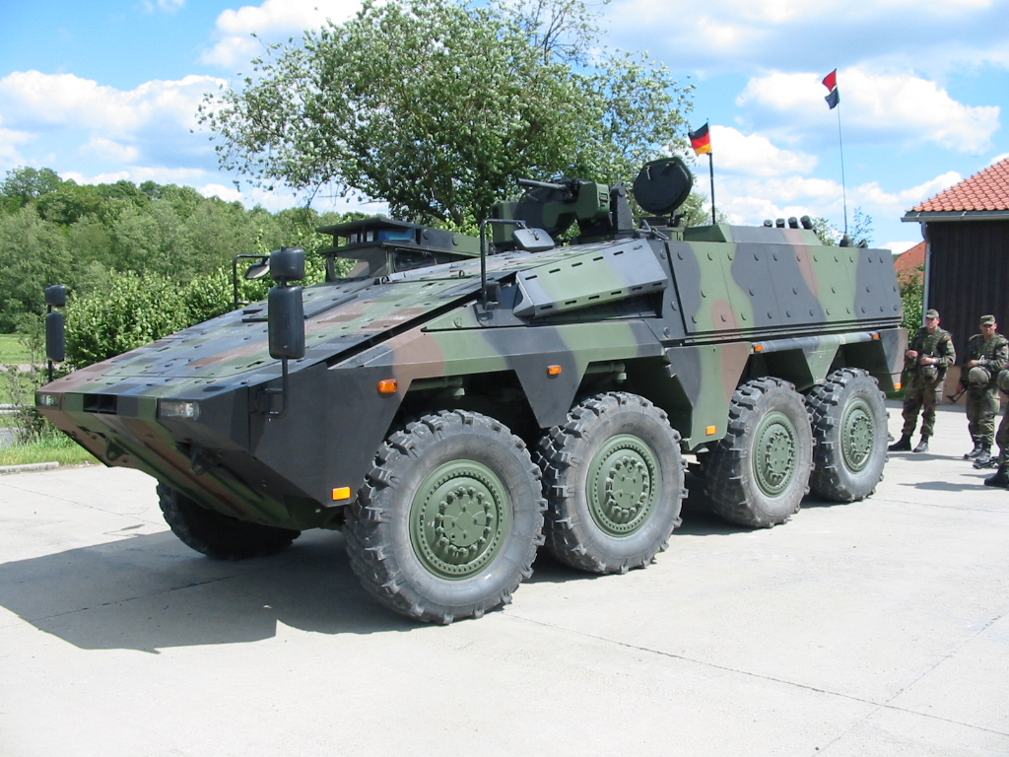
The Two Platforms:
Foxhound and Boxer
Foxhound LPPV (Light Protected Patrol Vehicle)
GVM: 7,500 kg | Max payload: ~2,000 kg | Engine: Steyr M16, 160 kW
Smallest British Army vehicle that could support a functional HEL
GVM ceiling is hard: higher GVM requires different driving licence in UK/Europe
Boxer MIV 8x8 (Mechanised Infantry Vehicle)
GVM: 38,500 kg | Payload: 15,000 kg (mission module)
Engine: MTU, 600 kW
623 vehicles on order (£2.8 billion); interchangeable mission modules
German Bundeswehr has ordered Skyranger 30 HEL (~50 kW near-term target) on Boxer chassis
Upper Slide: Photo: U.S. Army / DVIDS, public domain
Lower Slide: Photos: © Crown Copyright 2012 OGL; GTK Boxer, public domain
Notes:
Table 1 (paper): Platform payload budget for HEL integration.
Images:
Foxhound Light Protected Patrol Vehicle (LPPV) at Camp Bastion, Helmand Province, Afghanistan, June 2012. Photo: Sgt Andy Reddy RLC. © Crown Copyright 2012. Licensed under the Open Government Licence v1.0 (OGL v1.0). Source: UK Defence Imagery / Wikimedia Commons.
GTK Boxer 8×8 armoured vehicle (German Army). Photo: Heldt. Public domain. Source: Wikimedia Commons.

Slide 5
HEL Classification: Classes A-E
No standard taxonomy of HEL classes exists in published literature. This paper proposes one.
 | Maximum Output Power, kW | Target | Defeat Method
Class A | 30 | Light UAS/quadcopters | Soft kill: Sensor/electronics burn-out; thin plastic/composite skin ignition
Class B | 60 | Fixed-wing UAS/ loitering munitions | Soft kill: Warhead cook-off or control surface damage; fuselage skin penetration
Class C | 150 | Rotary-wing USA and light armored vehicles | Hard kill: Rotor blade severance; thin steel skin penetration and internal component destruction
Class D | 300 | Helicopters and fast jets | Hard kill: Airframe structural failure; fuel ignition through skin burn-through
Class E | 500 | Maximum ground vehicle scenaion | Hard kill: Thick steel armor penetration; structural failure of heavy vehicles
Derivation method:
Fluence-to-kill thresholds by target type (Zohuri 2016)
Cross-validated against open-source program evidence (known systems vs. target types defeated)
Class boundaries drawn at qualitative capability steps
Notes:
Table 3 (paper): Full class framework with program references and defeat mechanisms
Ballistic missile intercept (>500 kW) excluded: impractical for beam propagation and aiming from ground vehicles, as the distance to airborne objects is too great for precision aiming.

Slide 6
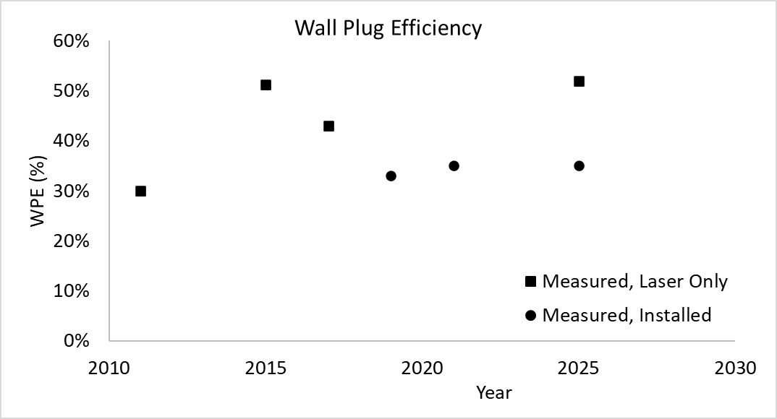
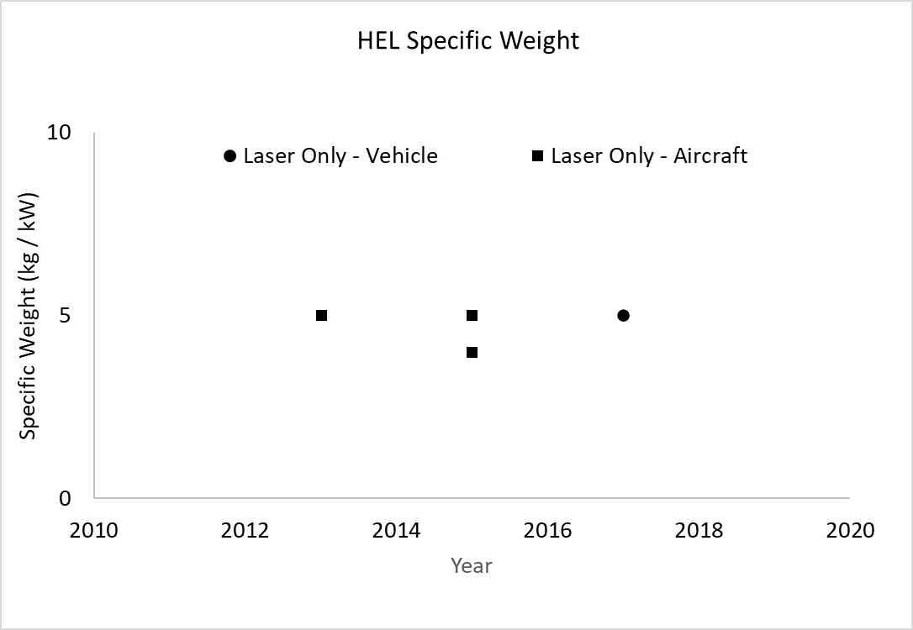
Power and Mass Drivers:
WPE and Thermal Management
Wall-Plug Efficiency (WPE):
Laboratory (laser head only): 50-56% Installed (full system incl. PTMS): ~33%
No improvement trend in field data (2015-2025)
Gap explained by: chiller, pumps, compressors, controls billed to a separate circuit
Power and Thermal Management System (PTMS) - the dominant mass item:
Absorbs burst waste heat during firing (phase-change material thermal store)
Rejects cycle-average heat during recovery (vapor-compression chiller)
Cannot use ram-air / low-temperature air (unlike aircraft) - active chiller required to 49°C
Chiller specific mass: 4.0-5.5 kg/kW(thermal)
Laser source specific mass: 4-5 kg/kW - also no improvement trend across all power classes and years
Wall Plug Efficiency (output power / input power, %)
HEL Specific Mass (kg/kW)
Notes:
Key implication: Cannot wait for the technology to mature - must design for current values.

Slide 7
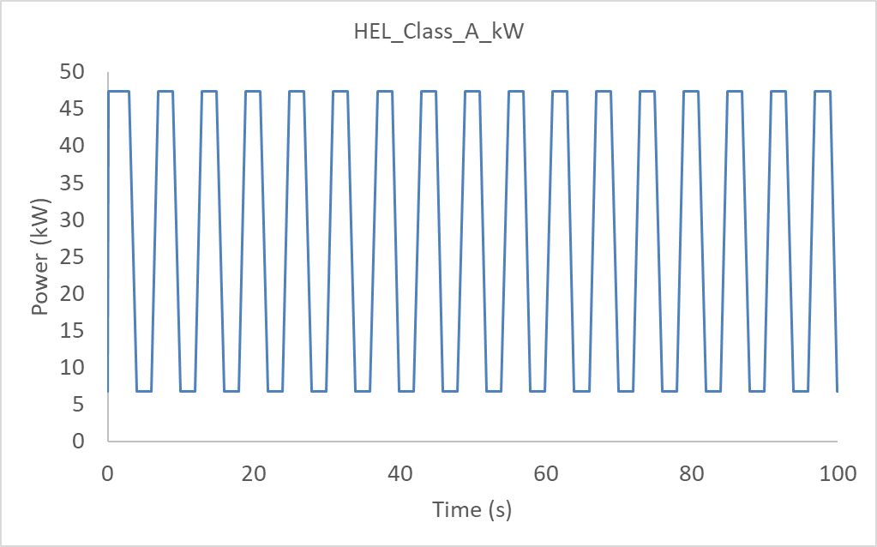
Engagement Cycle and
Sustained Firing Fraction (SFF)
Three-phase engagement cycle:
1. Firing phase: laser on, high power draw, waste heat generated
2. Re-acquire phase: beam slews to next target (several seconds)
3. Thermal recovery: PTMS drains phase-change store; laser off, chiller at full load
SFF = fraction of total cycle time during which the laser fires
Upper bound: SFF = 83% (DragonFire dwell time; zero recovery time assumed)
Adopted value / tactical floor: SFF = 50% (a system in recovery >50% of the time lacks tactical utility)
Ultracapacitors smooth the power demand:
High power density, short duration: ideal fit for firing/recovery cycle
Class E example: two Skeleton SkelMod modules, 70 kg, store 417 Wh - negligible added mass
Vehicle need only supply average power, not firing peak
Power demand for HEL system. Alternating firing and thermal recovery, for SFF = 50%.
This power demand can be smoothed to a near-constant average value, by the use of ultracapacitors.

Slide 8
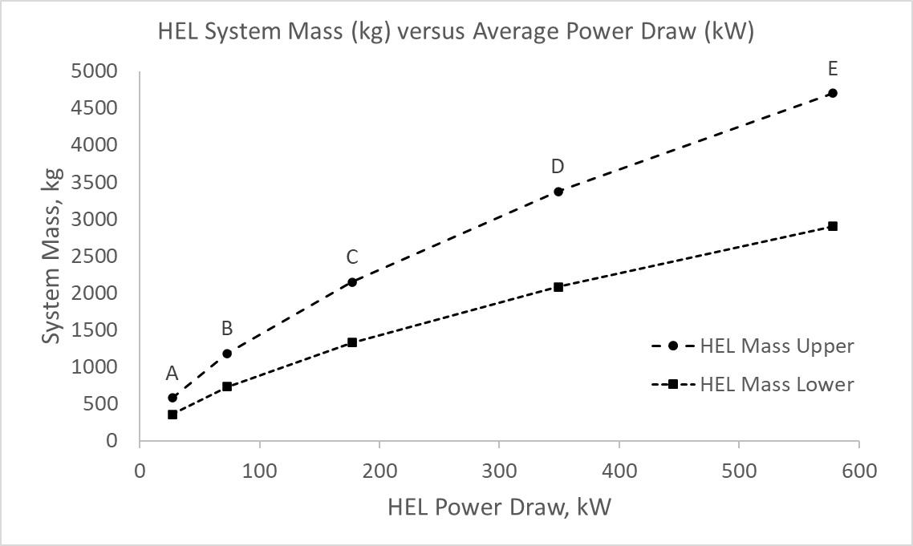
HEL Electrical Demand
and Mass, by Class
Two simultaneous constraints the powertrain must satisfy for each HEL class:
1. Average electrical demand (kW) during engagement phase
Dominant loads: laser chain + chiller (both scale with class);
beam director + sensors (fixed)
Chiller COP: 3.7 (Carnot analysis, cross-validated against published
vapor-compression data)
Installed system WPE converges at Class C+ as chiller dominates;
fixed loads matter at Class A
2. Installed system mass (kg)
Laser source: 4-5 kg/kW
PTMS: 4.0-5.5 kg/kW(thermal), at cycle-average waste heat rejection rate
EPS on series hybrid: 0.5-1.0 kg/kW (DC bus already present; AC front-end eliminated)
Beam director and fixed systems: approximately constant across class
HEL System Mass (kg) versus Operational Power Draw (kW).
Notes:
Table 5 (paper): Electrical demand and system WPE by class
Table 6 (paper): Installed HEL mass range by class

Slide 9
Analysis Methodology: CEMP-H and powersize.tech
CEMP-H Mission Profile:
24-hour charge-neutral cycle: 5 hr Silent Watch | 2 hr Silent Mobility | 1 hr weapons engagement | base-rest Export Power
Average HEL electrical demand added as continuous DC load during the 1-hour engagement phase
Powersize.tech - rapid parametric powertrain screening:
Inputs: vehicle mass, rolling resistance, drag, frontal area, max speed, electrical loads, Export Power
No detailed BSFC maps required - concept-stage open-source data only
Output: minimum engine power, battery capacity, component masses and costs
Component sizing - sequential efficiency cascade:
Series chain: engine → MGU → rectifier → inverter → traction motor → driveline
Each stage derated by component-class efficiency from powersize.tech database
Engine power floor: no lower than current platform spec (160 kW Foxhound / 600 kW Boxer)
Notes:
CEMP mission profile is a new profile for tactical wheeled vehicles, proposed in the paper.

Slide 10
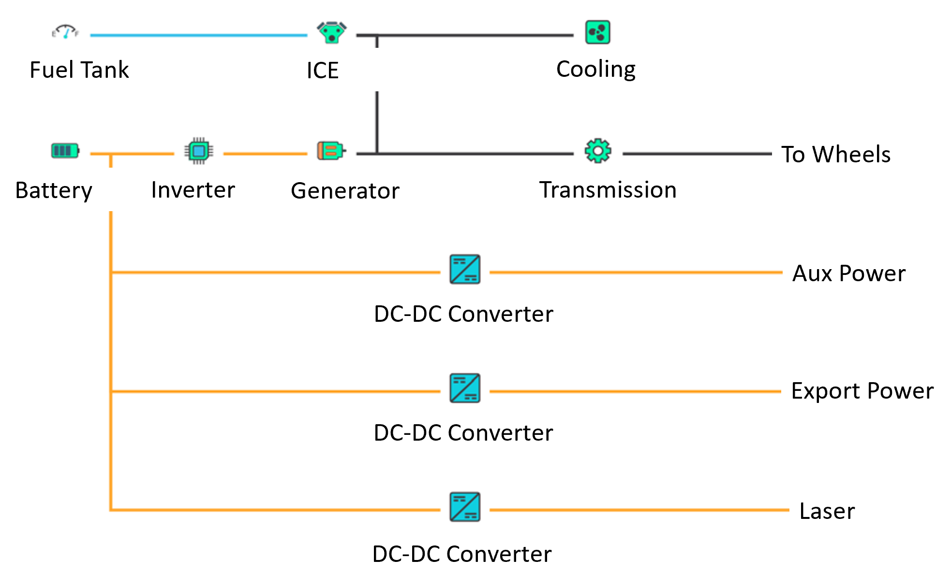
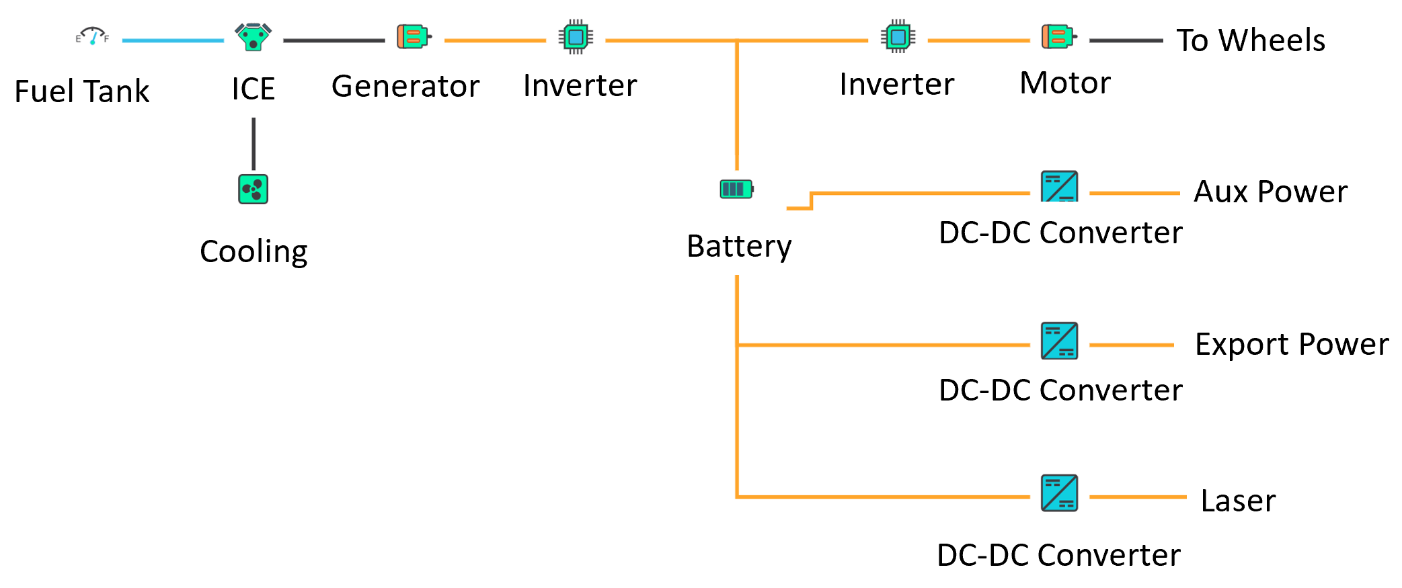
Parallel vs. Series Hybrid Architecture
Both architectures sized. Series hybrid selected for HEL integration.
Parallel hybrid:
Engine and motor both connect mechanically to driveline
Engine operating point constrained by traction demand - HEL load not fully decoupled
Lower mass and cost - used as reference baseline in Tables 7 and 8
Series hybrid:
Engine drives generator only; wheels driven electrically
Engine, traction, and HEL loads fully decoupled - each optimised independently
High-voltage DC bus already standard in drivetrain
HEL EPS reduces to DC-DC converter + EMI filter only (AC front-end eliminated)
EPS mass: 0.5-1.0 kg/kW vs. 1.0-2.0 kg/kW for standalone diesel-generator EPS
Parallel-Hybrid Architecture with HEL Power Output
Series-Hybrid Architecture with HEL Power Output
Notes:
Batteries for Silent Watch/Mobility also support limited HEL operation with engine off

Slide 11
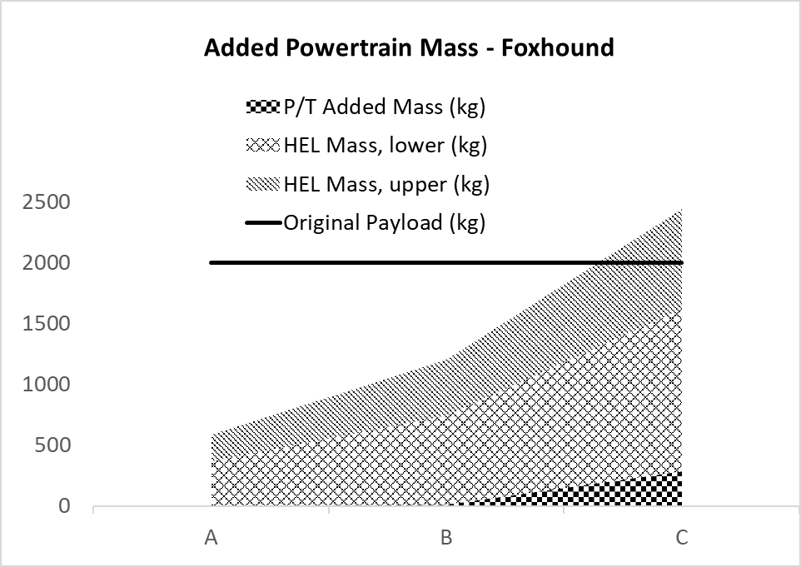
Results: Foxhound LPPV
Foxhound evaluated for Classes A, B, C only (payload constraint).
Minimum retained payload: 240 kg (driver + gunner at 95th percentile NATO male + kit)
ICE baseline:
160 kW engine; 2,000 kg payload available for HEL system + powertrain additions
Step 1 - Series hybridization (no HEL):
+1,126 kg powertrain addition; assumes weight savings elsewhere preserve 2,000 kg payload target
Step 2 - Add HEL:
Class A (30 kW): minimal engine change; small mass addition; payload comfortable
Class B (60 kW): minimal engine change; payload remains viable
Class C (150 kW): engine uprate to 228 kW required; +274 kg; feasible only if HEL mass near lower estimate
System Mass (kg) versus HEL Class – Foxhound
Notes:
Table 7 (paper): Full specifications and mass for all Foxhound configurations

Slide 12
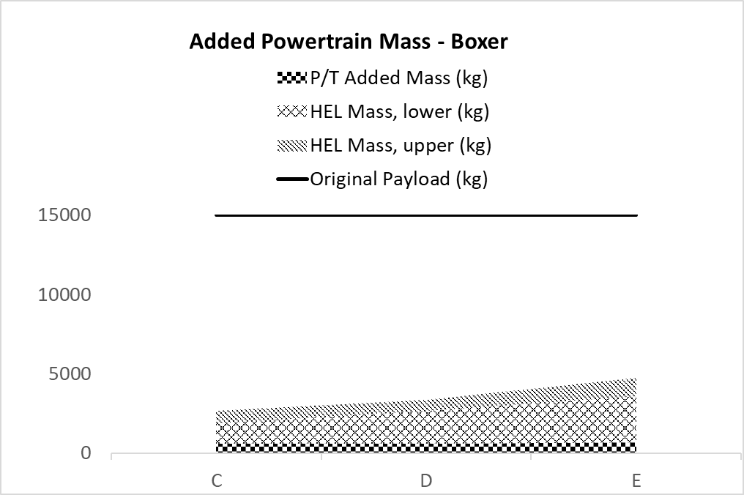
Results: Boxer MIV
Boxer evaluated for Classes C, D, E. Payload: 15,000 kg.
Weight is not the limiting factor.
ICE baseline:
600 kW engine; 15,000 kg mission module payload available
Step 1 - Series hybridization (no HEL):
Substantial powertrain addition; payload margin remains very large
Step 2 - Add HEL:
Class C (150 kW): no engine uprate required; payload impact manageable
Class D (300 kW): no engine uprate required; payload comfortably within budget
Class E (500 kW): engine uprate to 704 kW required; still within payload budget
704 kW and 228 kW (Foxhound Class C) are both commercially available engines.
System Mass (kg) versus HEL Class – Boxer
Notes:
Table 8 (paper): Full specifications and mass for all Boxer configurations

Slide 13
Discussion: Synergies of Hybridization
The series hybrid creates compound value for HEL integration:
1. Engine fully decoupled from HEL and traction - no interference between demands
2. DC bus already present - HEL EPS is only DC-DC converter + EMI filter
Saves 0.5-1.0 kg/kW in EPS mass vs. standalone EPS; saving scales with class
3. Batteries sized for Silent Watch / Mobility support limited HEL with engine off
Foxhound: 65 kWh | Boxer: 210 kWh
4. If engine power is insufficient, mitigation options:
Reduce SFF below 50% | Reduce chiller size (accept de-rating at high ambient temperature)
Seek improved WPE from laser supplier | Reduce target laser output class
Conclusion:
If Hybridized for Silent Watch and Silent Mobility, HEL integration comes at low incremental cost.

Slide 14
Conclusions
1. Novel HEL classification (Classes A-E):
Defined by target type and laser output, 30-500 kW; covers all ground vehicle scenarios
2. Foxhound in series hybrid form:
Supports Class A-B with minimal powertrain modification (CEMP-H spec for Silent Watch/Mobility assumed). Class C attainable with engine uprate to 228 kW.
3. Boxer in series hybrid form:
Supports Class C-D within payload and existing engine power. Class E (500 kW) attainable with engine uprate to 704 kW.
4. powersize.tech enables concept-stage analysis:
Open-source vehicle data only; no specialist simulation expertise; multiple HEL classes and platforms screened simultaneously
5. Series hybrid is the preferred host architecture:
DC bus synergy reduces EPS mass; batteries support silent HEL engagement; HEL integration cost is incremental.

Slide 15
Questions
Notes:
Rupert Tull de Salis, PE, MEng, MSc
ZeBeyond Ltd, Leamington Spa, UK
rdesalis@umich.edu
www.linkedin.com/in/rupert-de-salis
Full paper preprint (with appendices):
DOI: 10.5281/zenodo.19113766
Companion paper (CEMP-H mission profile and workbooks):
DOI: 10.5281/zenodo.19113638
ePOP Concept: ZeBeyond Ltd | www.zebeyond.co.uk
DISTRIBUTION STATEMENT A. Approved for public release; distribution is unlimited.

